Slide 1
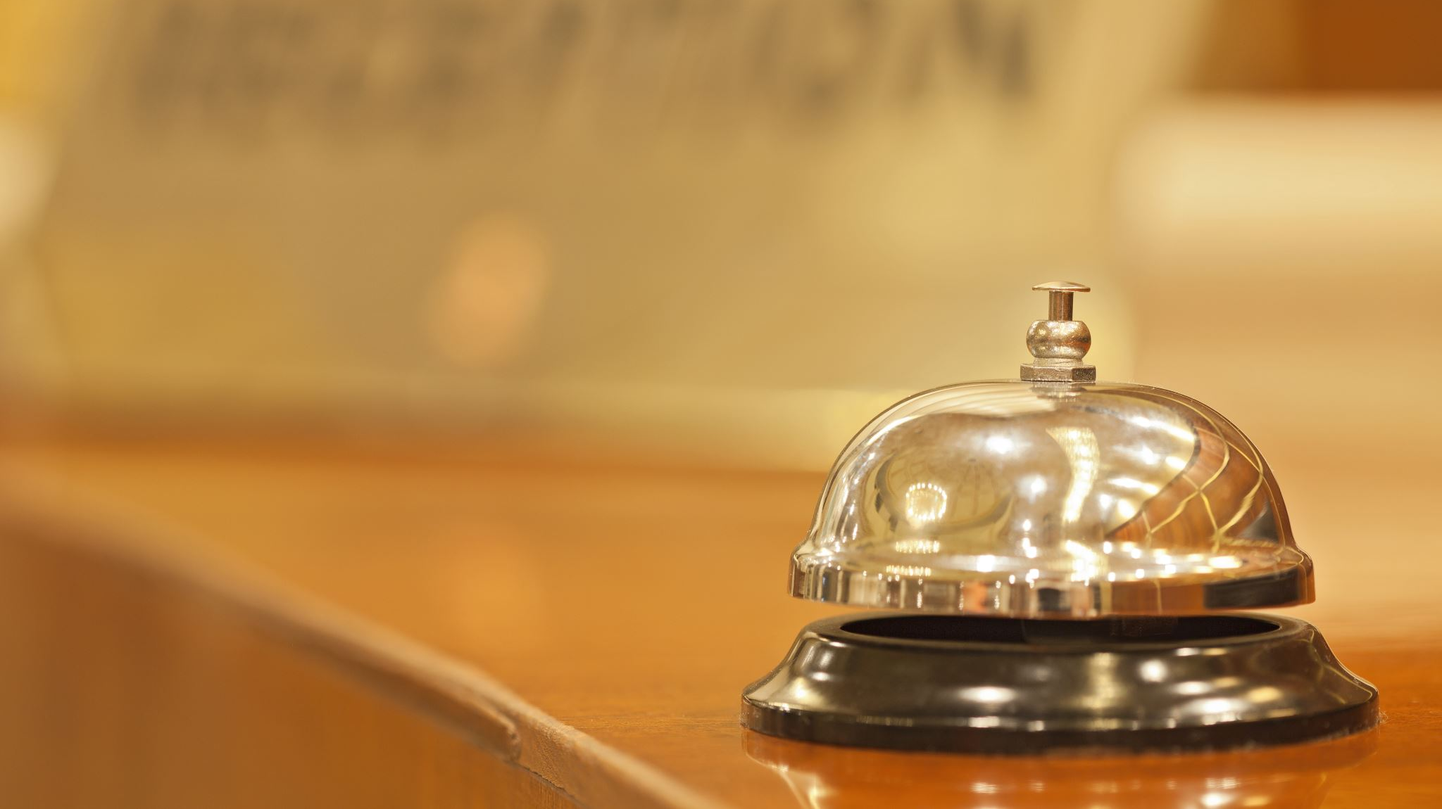
Hotel booking-cancellation prediction
Nishant 11910329
Pratyush Pranjal 11906033

Slide 2


WHY THIS PROJECT:
Huge industry like Hotel Business suffers loss because of frequent cancellations.
Revenue Loss
Operational Problems
Leads to bad reviews
Ultimately affects the overall industry.

Slide 3
Problem statement
Perform exploratory data analysis on the given dataset
Use Machine learning algorithms to build model assisting in booking cancellation

Slide 4
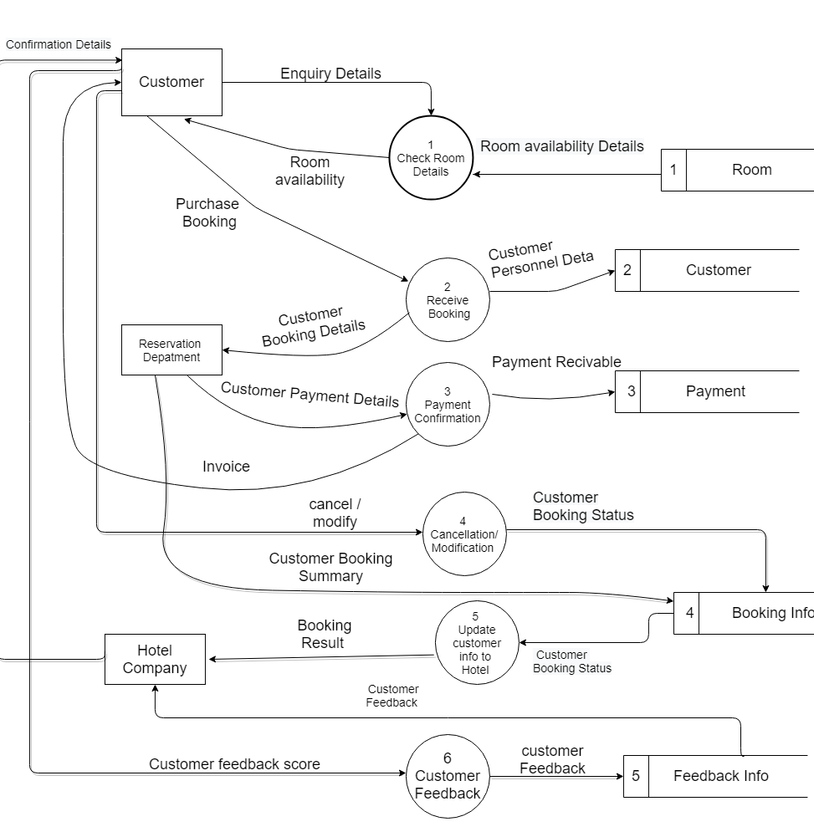
Actual system:
The DFD represents the current flow of data in the system prevalent now.

Slide 5
ML Algorithms:
Target Variable is of Binary type, i.e., Cancellation={0,1}, we needed a classification model.
Multiple Classifiers available, the ones we selected are:
Logistic Regression
Naïve Bayes
Random Forest
Decision Tree
KNN
SVM

Slide 6
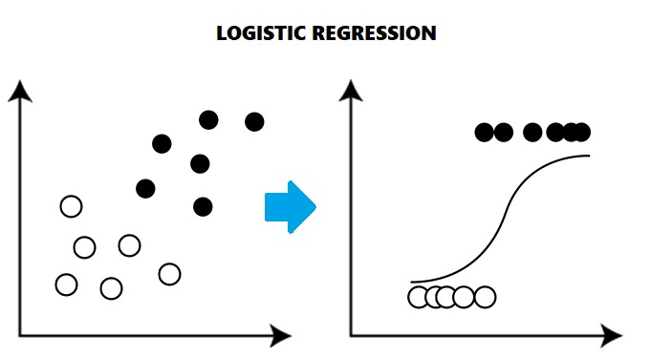
Logistic Regression:
The logistic model (or logit model) is used to model the probability of a certain class or event existing such as pass/fail, win/lose, alive/dead and cancelled/not. This can be extended to model several classes of events such as determining whether an image contains a cat, dog, lion, etc. Each object being detected in the image would be assigned a probability between 0 and 1, with a sum of one.

Slide 7
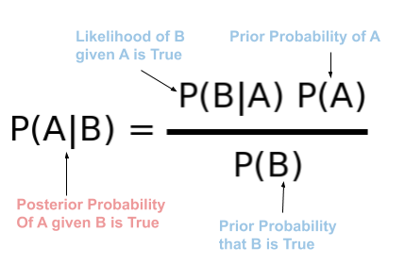
Naïve bayes:
Naive Bayes is a term that is collectively used for classification algorithms that are based on Bayes Theorem. For uninitiated, classification algorithms are those algorithms that are used to categorize a new observation into predefined classes.

Slide 8
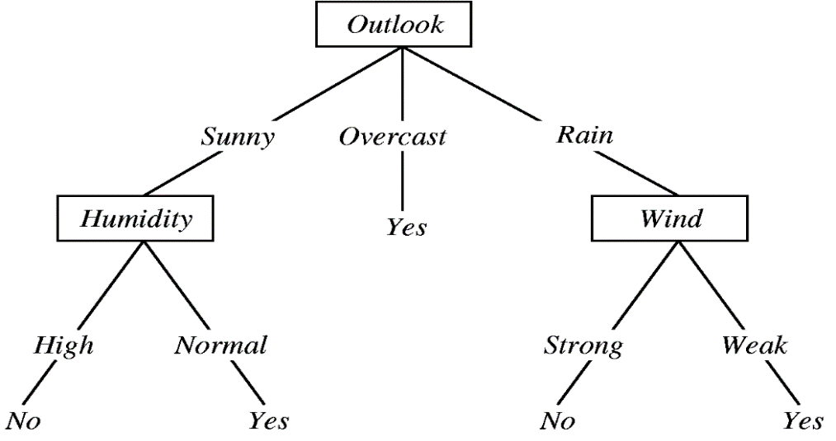
Decision tree:
A decision tree is a flowchart-like structure in which each internal node represents a test on a feature (e.g. whether a coin flip comes up heads or tails) , each leaf node represents a class label (decision taken after computing all features) and branches represent conjunctions of features that lead to those class labels. The paths from root to leaf represent classification rules.

Slide 9
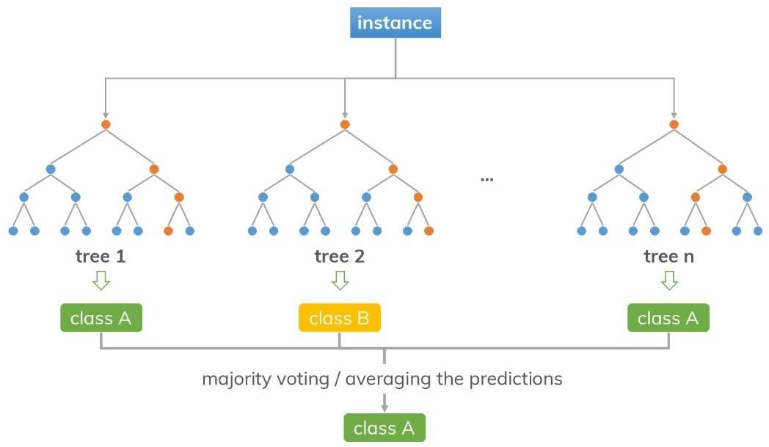
Random forest:
Random Forest is a popular machine learning algorithm that belongs to the supervised learning technique. It can be used for both Classification and Regression problems in ML. It is based on the concept of ensemble learning, which is a process of combining multiple classifiers to solve a complex problem and to improve the performance of the model.

Slide 10
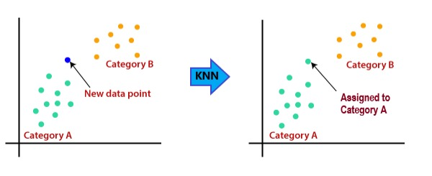
KNN:
K-Nearest Neighbors (KNN) is one of the simplest algorithms used in Machine Learning for regression and classification problem. KNN algorithms use data and classify new data points based on similarity measures (e.g. distance function). Classification is done by a majority vote to its neighbors. The data is assigned to the class which has the nearest neighbors. As you increase the number of nearest neighbors, the value of k, accuracy might increase.

Slide 11
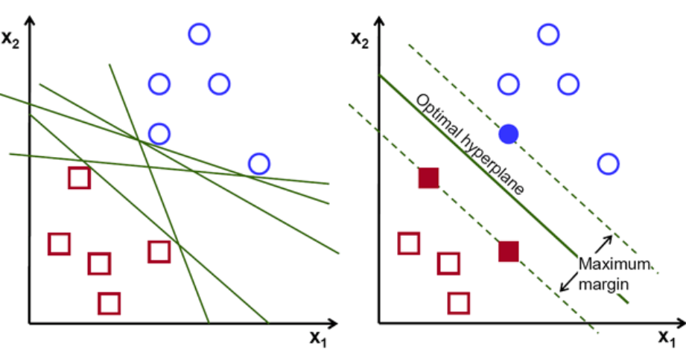
Support vector machine:
Support Vector Machine(SVM) is a supervised machine learning algorithm that can be used for both classification or regression challenges. However, it is mostly used in classification problems. In the SVM algorithm, we plot each data item as a point in n-dimensional space (where n is a number of features you have) with the value of each feature being the value of a particular coordinate. Then, we perform classification by finding the hyper-plane that differentiates the two classes very well.

Slide 12
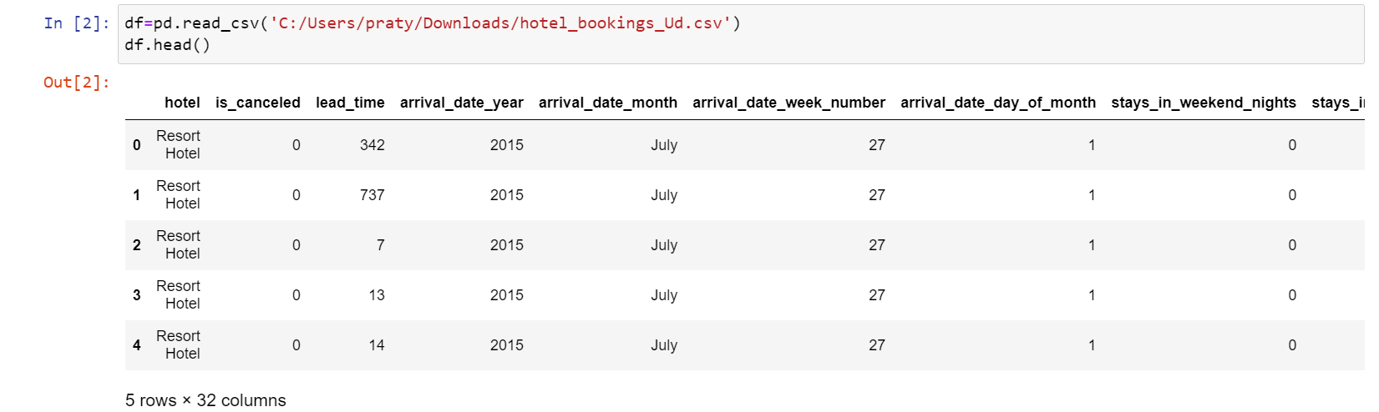
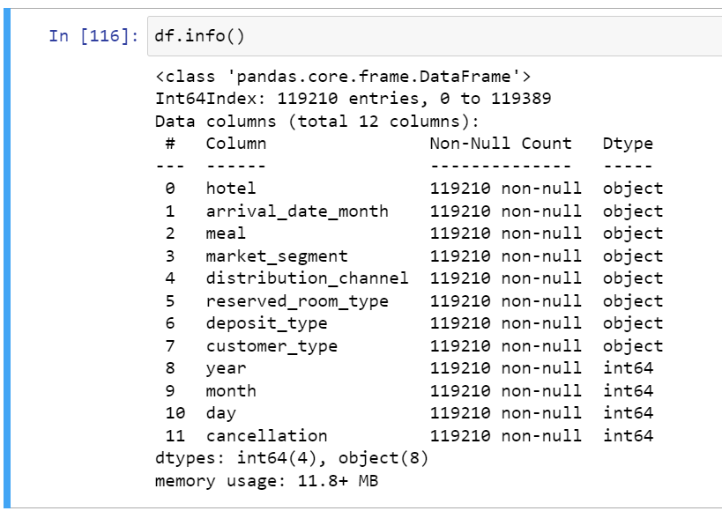
Data information

Slide 13
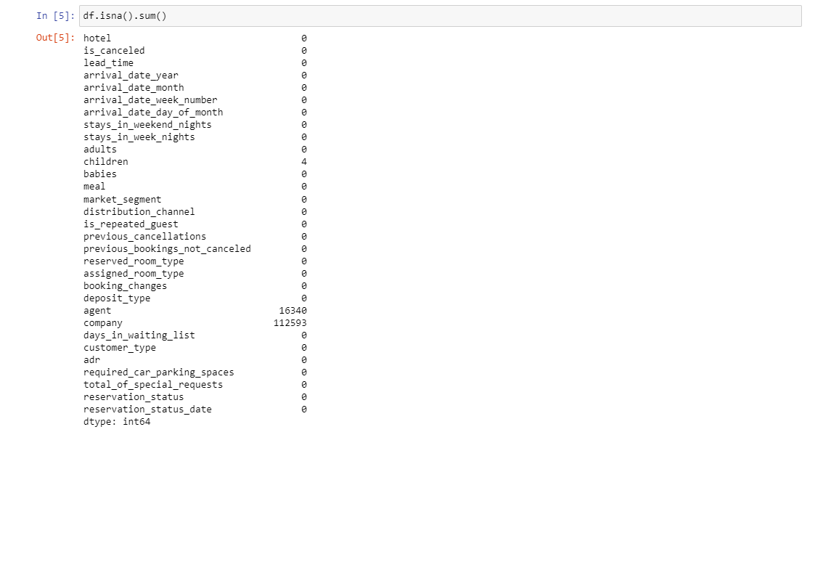
Data cleaning:
Calculating sum of null values
01
Removing redundant data
02
Performing EDA
03

Slide 14
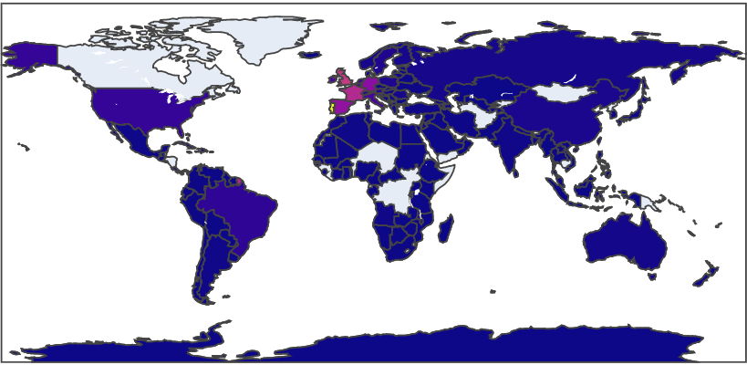
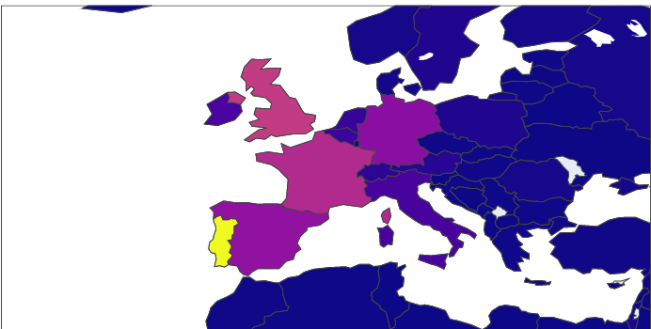
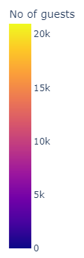
EDA Begins:
Multiple Pattern and Trends were recognized by answer few questions like:
Home countries of the guests

Slide 15
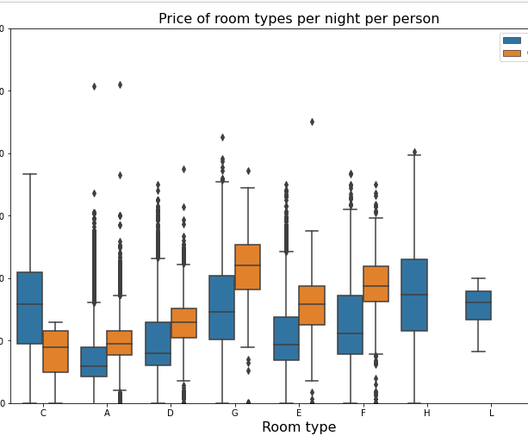
Prices of room per night per person

Slide 16
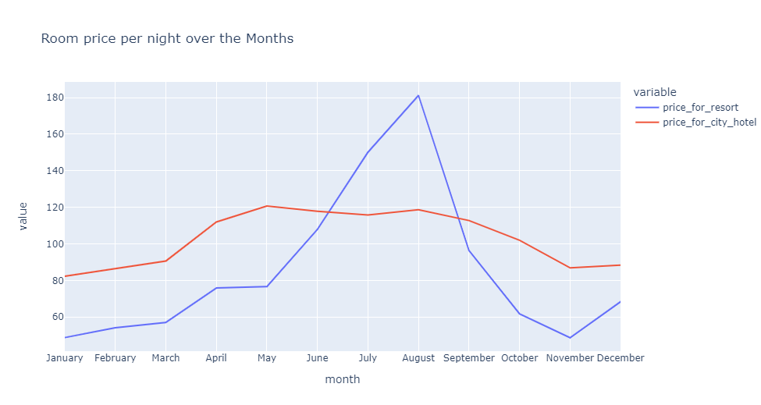
Room Price per night over the months

Slide 17
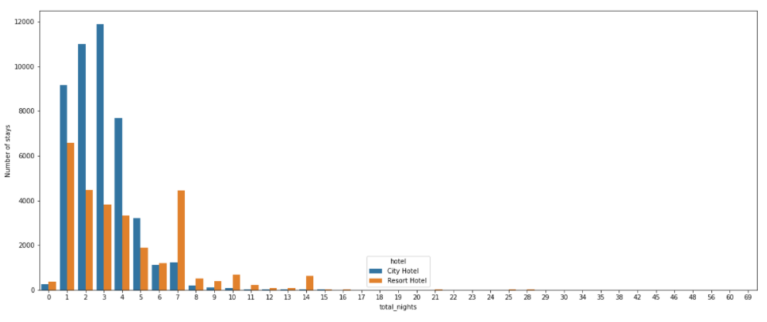
Total number of nights compared with total number of stays

Slide 18
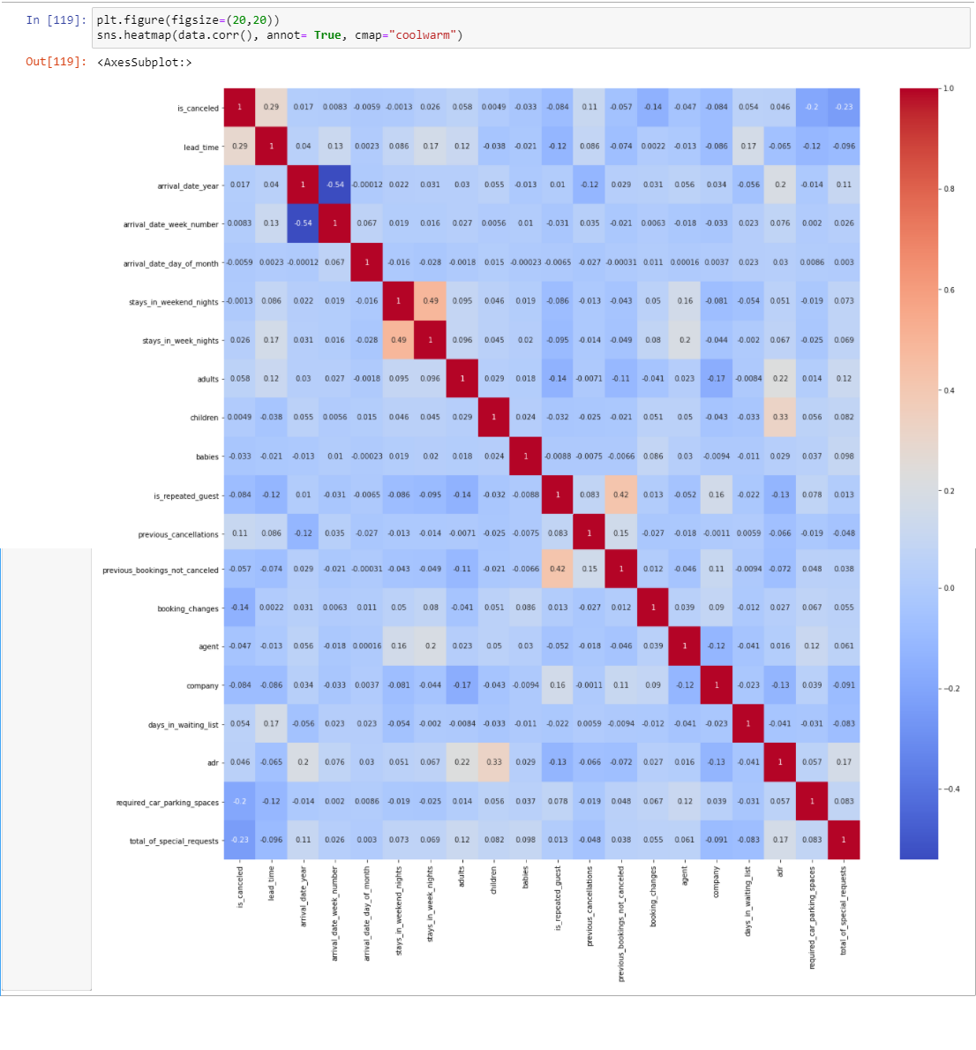
Correlation:

Slide 19
Result analysis:
Among the following, we achieved the best accuracy of 93.43563% with Random Forest, 92.72540% with Decision Tree and 92.75448% from KNN algorithm.

Slide 20
NOVELTY:
Building a classification model required classification algorithms.
Enquired about the most prominent algorithms.
Came across few that are rarely used in case of this topic.
Therefore, we used all of them, which gave the highest accuracies.

Slide 21
CONTRIBUTION:
Both of us looked for proper EDA questions, performed them as well.
Model building equally divided, chose 6 models in total, worked on 3 each.
Same sort of division was done with the Report and PPT as well.

Slide 22
Application of the project:
Restaurant Booking System
Travel Industry
Medical Industry

Slide 23
Future work/Limitations:
Real-Time Data availability not there.
Early phase of the project, so, it is still unavailable for public use.

Slide 24

Thank you

